Slide 1


Rajesh Senapati
May 06 2025

Slide 2
Outline
Executive Summary
Introduction
Methodology
Results
Conclusion
Appendix
2

Slide 3

Executive Summary
In this project, I was tasked to create a machine learning model that will predict if SpaceX will reuse the first stage.
I collected the data using webscraping. I got rid of null data and cleaned it up to make it more presentable. I also wrangled the data so that it would include data that made more sense.
I then explored the data by using SQL and visuals to better understand what it was telling me
I then created dashboards and created my predictive analysis
I concluded that the best model was the decision tree from my predictive analysis
3

Slide 4
Introduction
They can save millions of money if they reuse the first stage, meaning this first stage will need to land successfully
SpaceX is wanting to know if they can predict whether a Falcon 9 will land successfully or not
Use different modeling techniques to find the model to best predict the outcome
4

Slide 5

5

Slide 6
Methodology
Executive Summary
Data collection methodology:
Perform data wrangling
Perform exploratory data analysis (EDA) using visualization and SQL
Created charts/visuals and
obtained data using SQL queries, so data is easier to
understand
Perform interactive visual analytics using Folium
and Plotly Dash
Used map to visualize locations and distances. Created dashboard to better display data
Perform predictive analysis using classification models
Explain the problem and a
summary of the solution
Collected data by requesting and parsing the data using SpaceX API and webscraping
Cleaned data so that it is workable. Find the success rates
Built, tuned, evaluated classification models to determine the best model
6

Slide 7
Data Collection
Data Collection is separated into two sections
API
Webscraping
Each of these will use get requests to bring in data that will be used to predict the
successfulness of Falcon 9
7

Slide 8
Data Collection – SpaceX API
Flow:
1. def get(data)
Requests.get().json()
.append() to lists
4. data[data['columnname'].map(len)==1]
1. Create a get request for data such as rocket, launchpad, payloads, and cores using a function for each and appending to a list.
2. Request rocket launch data from SpaceX API using
requests.get() method
2. response=requests.get(url)
5. get(data) dict={}
df=pd.DataFrame(data=launch_dict)
3. Turn the JSON content into a pandas dataframe using
.json_normalize()
4. Clean the data to contain only what's wanted from each column
Call the functions from above, turn them into a dictionary, then turn the dictionary into a pandas dataframe
Remove Falcon 1 from list
Find null values. Replace them with the mean value
3. data=
pd.json_normalize(response.json())
6. df[df['BoosterVersion']!='Falcon 1']
7. data_falcon9.isnull().sum() data_falcon9['PayloadMass'].fillna(value=data_falcon9['PayloadMass'].mean(),
inplace=True)
SpaceY/jupyter-labs-spacex-data-collection-api.ipynb at main · RajeshSenapti/SpaceY
8

Slide 9
Data Collection - Scraping
Flow:
1. response=requests.get(static_url) soup=BeautifulSoup(response.text,
'html.parser')
1. Perform an HTTP GET method to request the Falcon9 Launch HTML page, as an HTTP response. Create a beautiful soup object for the response.
2. Extract all column names form the table. Use
.find_all() to find the 'th' elements.
2. soup.find_all("table") first_launch_table.find_all('th')
3. Append the Non-empty column name into a list
called column_names
4. Create an empty dictionary and extract each table
3. for i in headers:
if i!= None and len(i)>0:
title = i.text.strip()
column_names.append(title)
SpaceY/jupyter-labs-webscraping.ipynb at main · RajeshSenapti/SpaceY
4. dict.fromkeys(column_names)
.find_all() in for and if loops
9

Slide 10
Data Wrangling
Flow:
1. df=pd.read_csv("filename")
df.isnull().sum()/df.count()*100 df.dtypes
1. Read in the csv. Identify and calculate the percentage of the missing values in each attribute, and determine if columns are numerical or categorical
2. df['LaunchSite'].value_counts() df['Orbit'].value_counts()
landing_outcomes=
df['Outcome'].value_counts()
2. Calculate the number of launches per site, number of occurrences for each orbit, and the number of mission outcomes per orbit type
3. Find number of bad outcomes by going through the landing_outcomes and appending the false to a list
3. for i,outcome in
enumerate(landing_outcomes.keys()):
print(i,outcome)
bad_outcomes=set(landing_outcomes.key
s()[[1,3,5,6,7]])
4. Create a landing outcome label where it is 0 if it is a bad landing
5. Find the success rate by finding the mean
4. for outcome in df['Outcome']: if outcome in bad_outcomes: landing_class.append(0)
else:
landing_class.append(1)
SpaceY/labs-jupyter-spacex-Data wrangling.ipynb at main · RajeshSenapti/SpaceY
5. df["Class"].mean()
10

Slide 11
EDA with Data Visualization
1. sns.catplot(y="Y", x="X", hue="Class", data=df, aspect = 5) plt.xlabel("X",fontsize=20)
plt.ylabel("Y",fontsize=20)
plt.show()
Flow:
1. Read the csv in using pd.read_csv(). Create a scatter plot for each variable to see if there is a realtionship between the two variables. Do this for Flight # vs Payload Mass, Flight Number vs Launch Site, Launch Site vs Payload, Flight # vs Orbit Type, and Payload vs Orbit Type
2. grouped_df = df.groupby("Orbit") mean_df = grouped_df.mean() mean_df = mean_df.reset_index()
mean_df.plot(kind='bar', x='Orbit', y='Class', figsize=(10, 6))
2. Create a barchart for the success rate of each orbit
3. Create a chart that shows the launch success yearly trend
3. plt.plot(yearavg["Year"],yearavg["Class"]) plt.xlabel("Year") plt.ylabel("Success/Failure")
plt.show()
4. Apply OneHotEncoder to select columns
5. Cast entire dataframe to type float64
4. features_one_hot=pd.get_dummies(features, columns=['Orbit','LaunchSite', 'LandingPad', 'Serial'])
SpaceY/edadataviz.ipynb at main · RajeshSenapti/SpaceY
5. features_one_hot = features_one_hot.astype('float64')
1
1

Slide 12
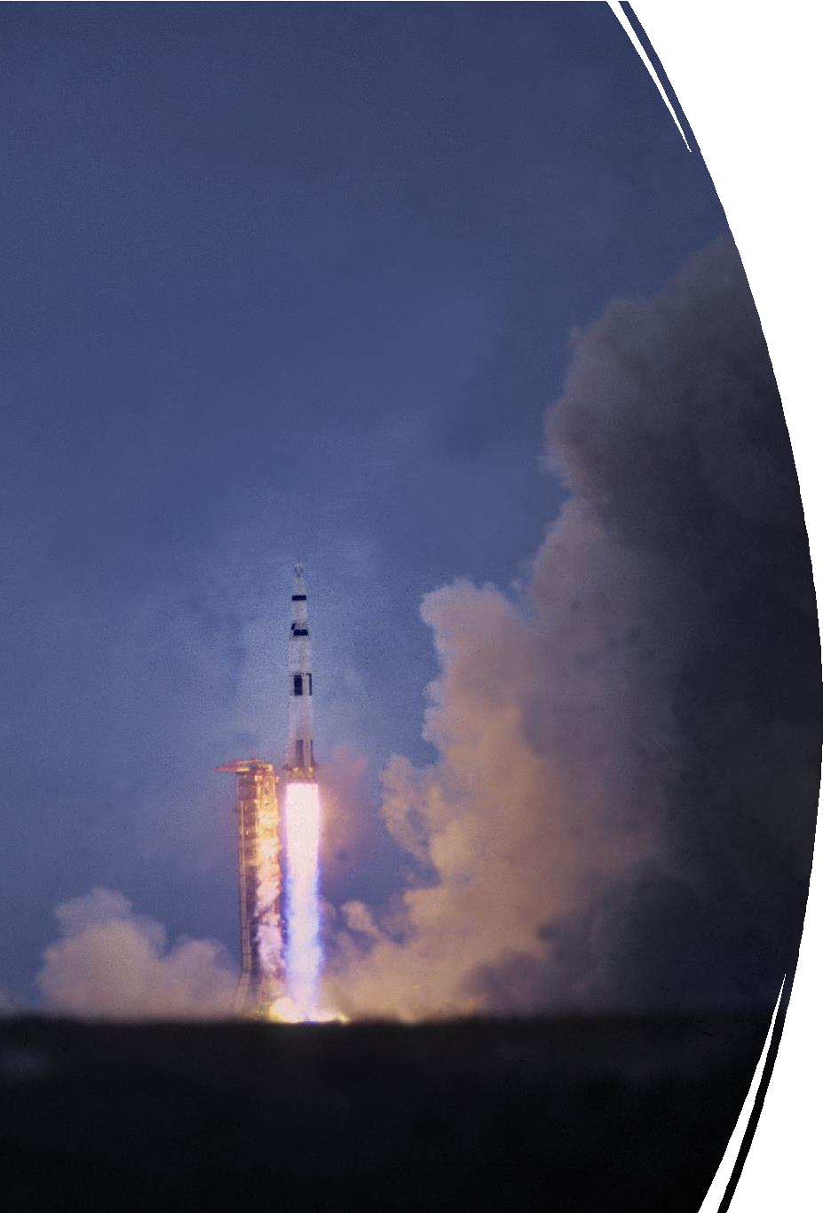
EDA with SQL
Display launch site names
Display 5 records that begin with string 'CCA'
Display the total payload mass carried by 'NASA (CRS)'
Display the average payload mass carried by booster version F9 v1.1
List the first date where the landing was successful
List names of boosters successful in drone ship and have payload mass between 4000 and 6000
List number of successful and failure outcomes
List names of booster_versions that carried the max payload mass
List the failed landing_outcomes in drone ship, their booster versions, and launch site names for in year 2015
Rank the count of landing outcomes between the date 2010-06-04 and 2017-03-20, in descending order
SpaceY/jupyter-labs-eda-sql-coursera_sqllite.ipynb at main · RajeshSenapti/SpaceY
12

Slide 13

Build an Interactive Map with Folium
Created a circle and marker for each launch site so that it was easier to pinpoint each location
Changed the marker color to indicate if it was successful or failed in landing
Created a marker of the coastal line to indicate the distance
between points
Drew a polyline from site to coastal line marker so that it is easier
to see how close/far away the markers are from each other
Created a marker with distance to a closest city, railway, and
highway to use
Drew a line between these markers and the launch sites to show
the proximity they were to different points.
SpaceY/lab_jupyter_launch_site_location.ipynb at main · RajeshSenapti/SpaceY
13

Slide 14


Build a Dashboard with Plotly Dash
I added a dropdown menu, so that users can choose to look at data for a specific landing site or for all sites.
I then added a pie chart that showed how successful the chosen landing site was. This made it easier for users to determine which site was most successful
Afterwards, I added a range slider so that users can decide which range of payload mass they wanted to look at for that specific site.
To accompany the range slider, I created a scatter plot that showed the range chosen and if that booster version was successful or not.
14

Slide 15

Predictive Analysis (Classification)
Create a NumPy array for 'Class' column
Standardize and transform the data in X
Split X and Y into training and testing data
Create a logistic regression
Calculate accuracy of test data
Create a Support vector machine object
Create a decision tree classifier
Create a k Nearest Number object
Find the best algorithm by creating a dictionary of the accuracy scores and returning the max score
*Flowchart is on next slide!
SpaceY/SpaceX_Machine Learning Prediction_Part_5.ipynb at main · RajeshSenapti/SpaceY
15

Slide 16
6. svm = SVC()
gscv =
GridSearchCV(svm,parameters,scorin
g='accuracy',cv=10)
svm_cv = gscv.fit(X_train,Y_train)
1. Y=data['Class'].to_numpy()
Predictive Analysis
Flowchart
2. transform =
preprocessing.StandardScaler()
X = transform.fit_transform(X)
7. tree = DecisionTreeClassifier() gscv = GridSearchCV(tree,parameters,scori ng='accuracy',cv=10)
tree_cv = gscv.fit(X_train,Y_train)
3.X_train, X_test, Y_train, Y_test
= train_test_split(X, Y, test_size=0.2, random_state=2)
8. KNN = KNeighborsClassifier() gscv = GridSearchCV(KNN,parameters,scorin g='accuracy',cv=10)
knn_cv = gscv.fit(X_train,Y_train)
4.parameters ={"C":[0.01,0.1,1],'penalty':['l2'], 'solver':['lbfgs']}
lr=LogisticRegression()
gscv = GridSearchCV(lr,parameters,scoring='accuracy',cv=10) logreg_cv = gscv.fit(X_train,Y_train
9. algorithms =
{'KNN':knn_cv.best_score_,'Tree':t
ree_cv.best_score_,'LogisticRegres
sion':logreg_cv.best_score_} bestalgorithm = max(algorithms, key=algorithms.get)
5.logreg_cv.score(X_test,Y_test)

Slide 17
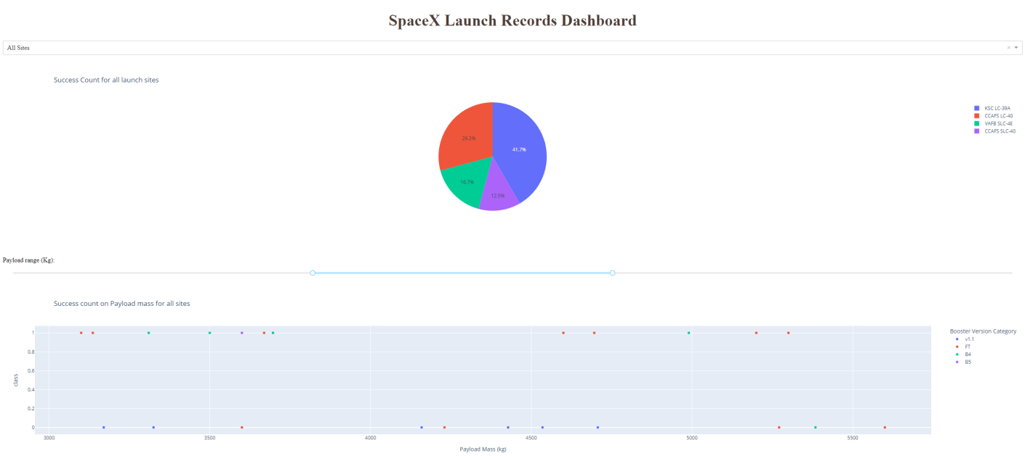
Results
Exploratory data analysis results: saw trends between landing sites and which were
successful. Can see that success rates have mostly increased as the years have increased
Interactive analytics demo:
Predictive analysis results: Found that the best algorithm is Tree with a score of 0.8875
17

Slide 18





Insights drawn
Section 2
from EDA

Slide 19
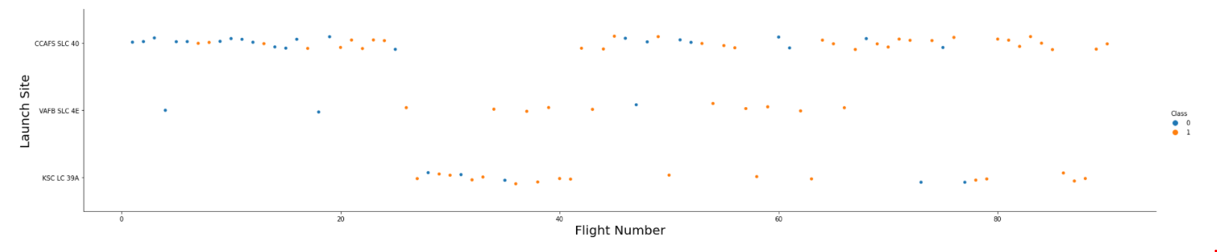
Flight Number vs. Launch Site
This plot shows each flight number organized by the launch site. If the dot is blue,
then it was a failed mission. If the dot is orange, it shows a successful mission

Slide 20
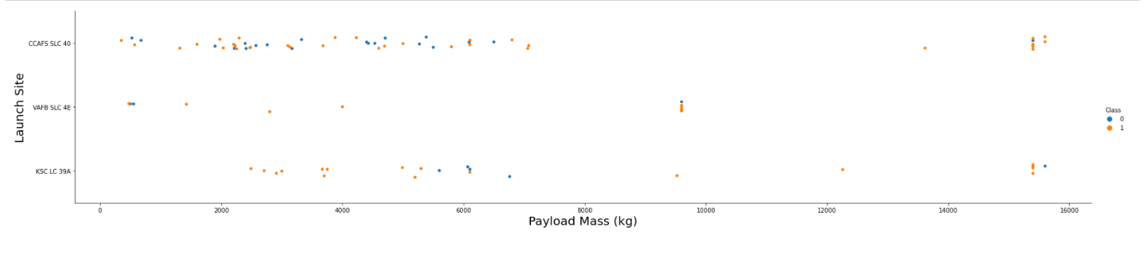
Payload vs. Launch Site
This scatterplot shows the relationship between Payload mass and launch sites. Most flights had a smaller payload mass, but it seems as if the flights with higher payload mass was more successful.

Slide 21
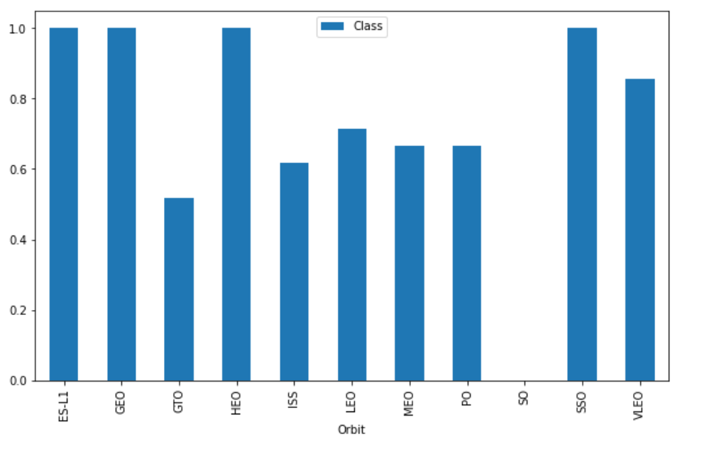
Success Rate vs. Orbit Type
Most orbits had an over 50% successful rate, but GTO and SO were low. SO had no flights that were successful

Slide 22
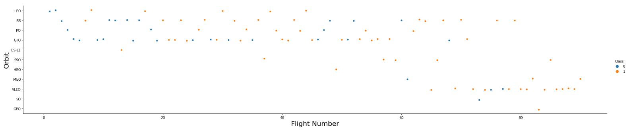
Flight Number vs. Orbit Type
This plot shows which flight numbers were in which orbit type. Smaller flight numbers
were in the top portion of the orbits.

Slide 23
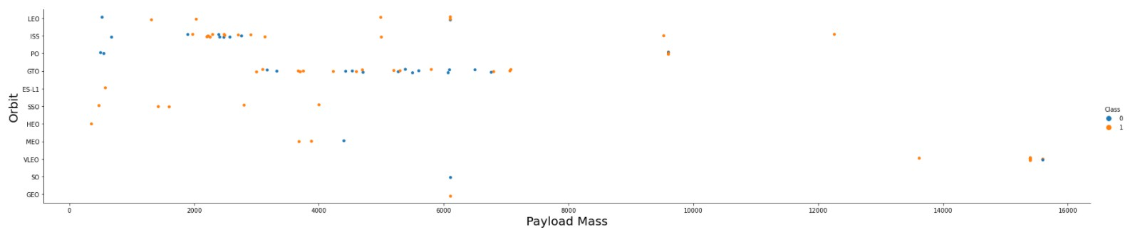
Payload vs. Orbit Type
This plot shows payload mass of each orbit. Most orbits had a smaller payload mass.

Slide 24
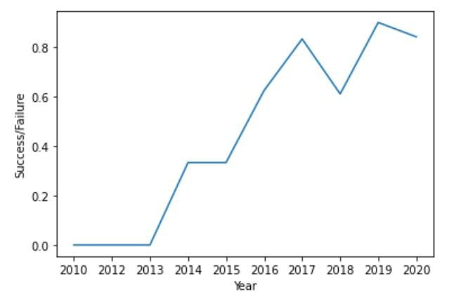
Launch Success Yearly Trend
This line chart shows that as the years increase, the success rate also tends to increase

Slide 25
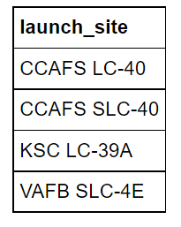
All Launch Site Names
Find the names of the unique launch sites
This output shows all the different launch sites that are included in the data

Slide 26
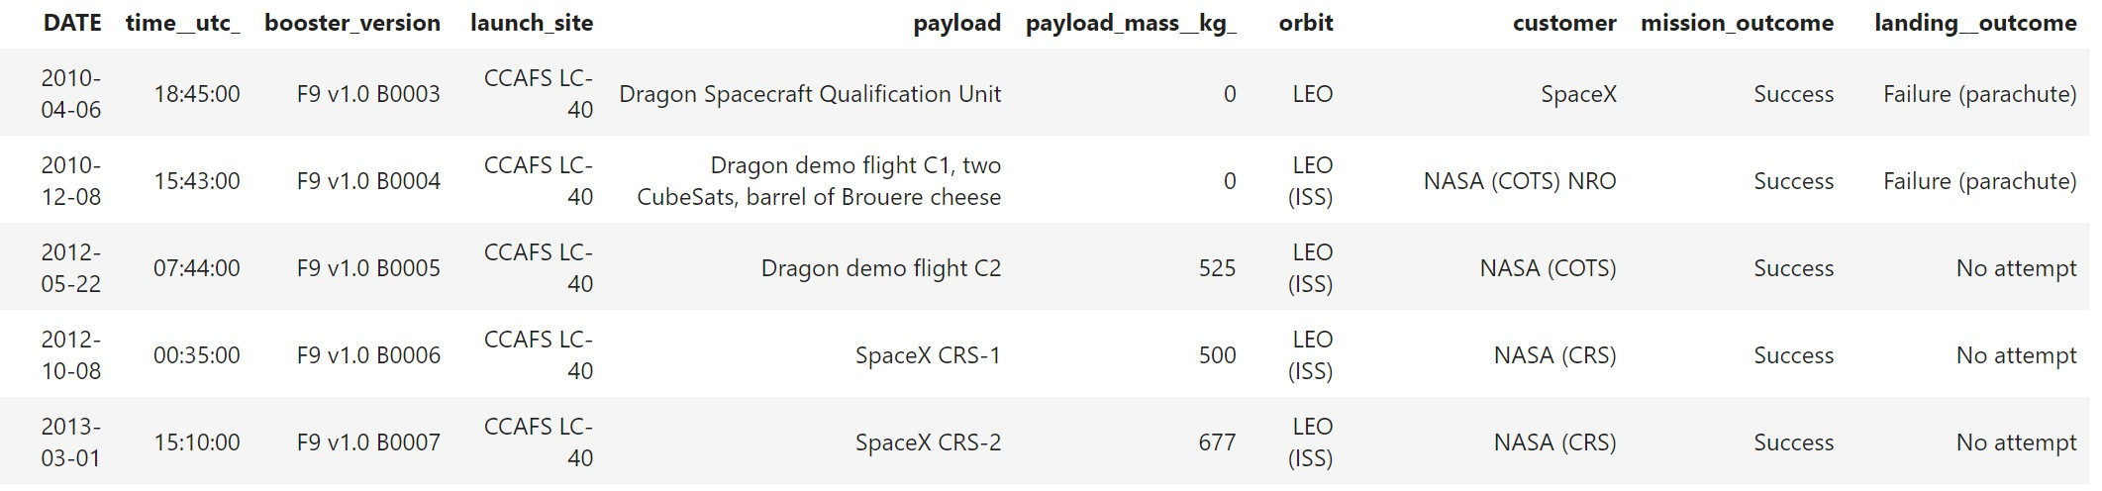
Launch Site Names Begin with 'CCA'
Find 5 records where launch sites begin with `CCA`
Here is a list of the first 5 records where the launch sites beegin with CCA. It
includes all the data for each of these records.

Slide 27
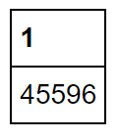
Total Payload Mass
Calculate the total payload carried by boosters from NASA. Had to use the
sum function on payload mass to obtain this result and filter by NASA

Slide 28
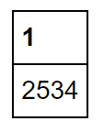
Average Payload Mass by F9 v1.1
Calculate the average payload mass carried by booster version F9 v1.1. Had to use the average function on payload mass to obtain this and filter by booster version

Slide 29
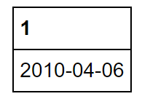
First Successful Ground Landing Date
Find the dates of the first successful landing outcome on ground pad.
This shows the first successful landing obtained by using the min function on the dates where successful is the outcome.

Slide 30
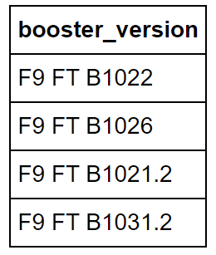
Successful Drone Ship Landing with Payload between 4000 and 6000
List the names of boosters which have successfully landed on drone ship and had payload mass greater than 4000 but less than 6000
Shown from scatterplots, the most successful landings were less than 4000 and greater than 6000, so the in between successes would be small. This shows just how few successful landings there were when the payload mass is not too small, but not too large.

Slide 31
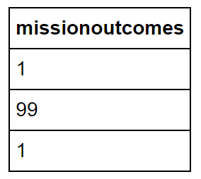
Total Number of Successful and Failure Mission Outcomes
Calculate the total number of successful and failure mission outcomes
This shows that there 3 mission outcomes: 99 successful, 1 failure (in flight), and 1 success (payload status unclear)

Slide 32
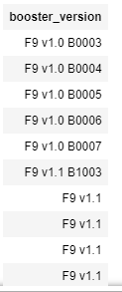
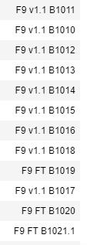
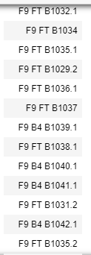
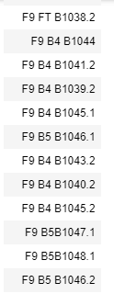
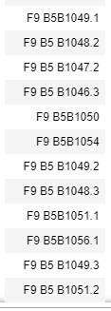
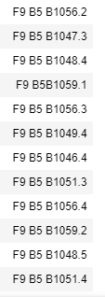
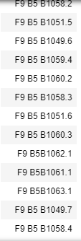
Boosters Carried Maximum Payload
List the names of the booster which have carried the maximum payload mass
This shows that many booster versions have carried the maximum payload mass. There were a lot of booster versions that have carried the max payload mass
32

Slide 33
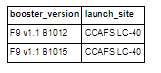
2015 Launch Records
List the failed landing_outcomes in drone ship, their booster versions,
and launch site names for in year 2015
This shows that 2 booster versions at the same launch site had a failed landing outcome

Slide 34
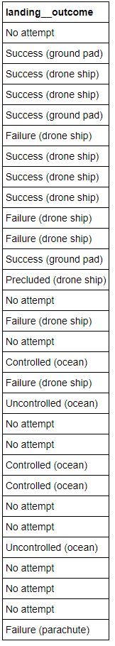
Rank Landing Outcomes Between 2010-06-04 and 2017-03-20
Rank the count of landing outcomes (such as Failure (drone ship) or Success (ground pad)) between the date 2010-06-04 and 2017-03-20, in descending order
This shows the many different landing outcomes that were shown between those two dates

Slide 35
Launch Sites
Section 4
Proximities Analysis

Slide 36
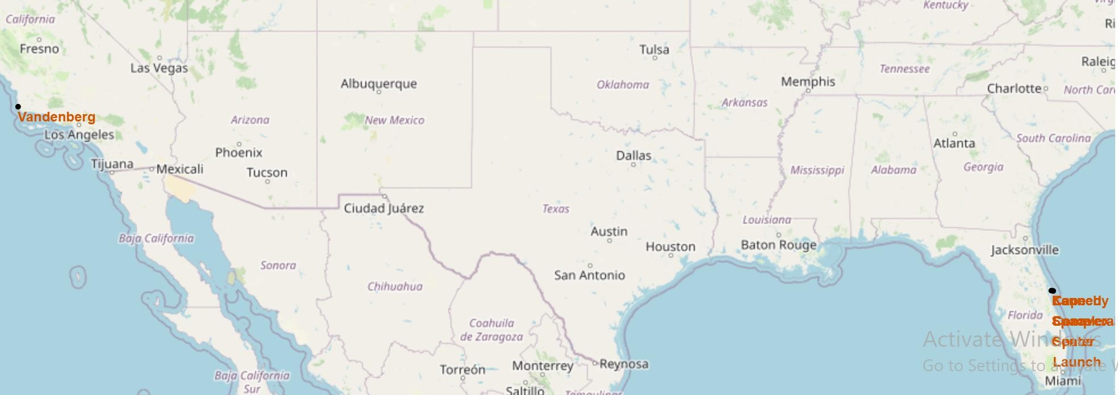
Launch Sites' Location Markers on Global Map
Here you can see all the different launch sites have a marker and their appropriate label on the map. Three of the launch sites are bunched together in Florida

Slide 37
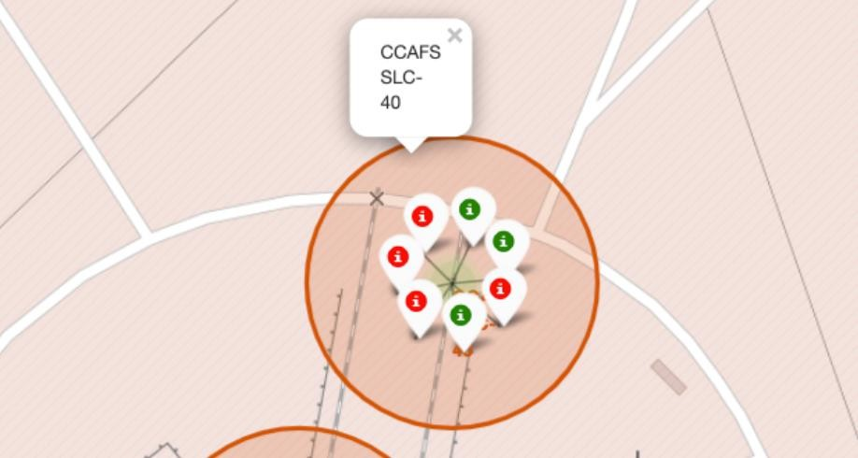
Color Labeled Outcomes of CCAFS SLC-40
This shows the number of outcomes with red being failure and green being successful for this specific launch site on the map.

Slide 38
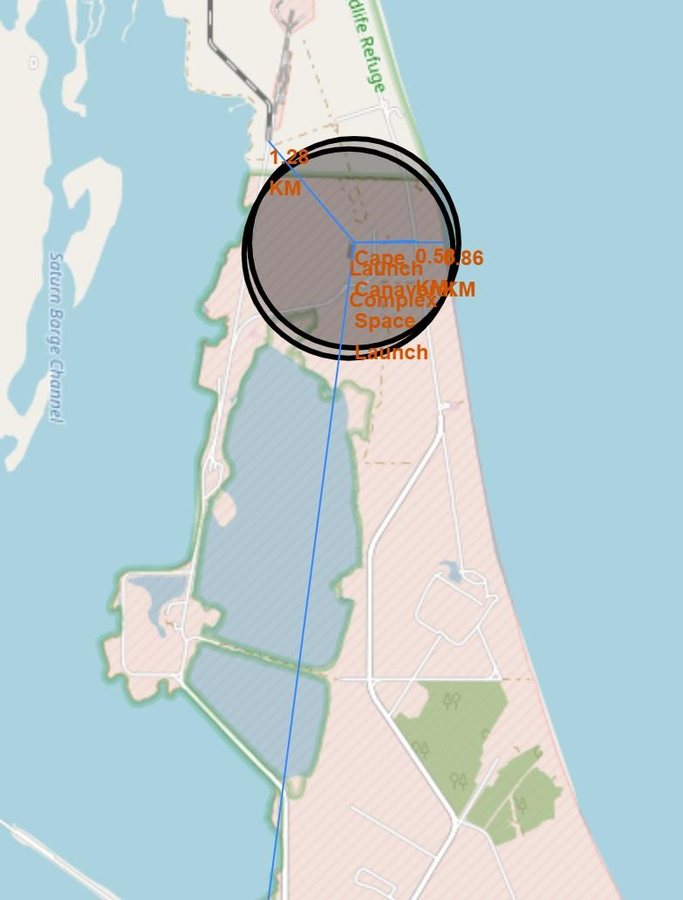
Distances of Landmarks from Launch Site
This shows a few distances from coastline, highway, and closest launch site to this site in Florida.

Slide 39

Build a Dashboard
Section 5
.
with Plotly Dash

Slide 40
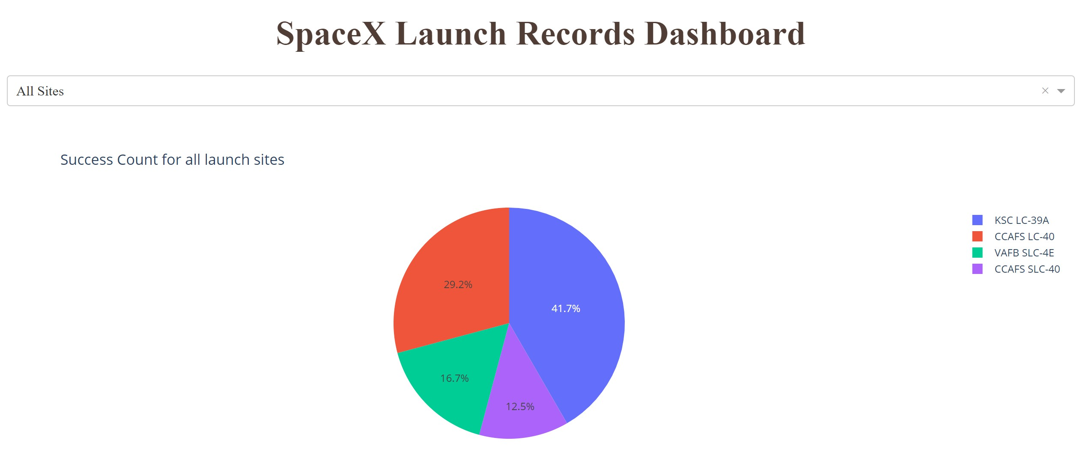
Dasboard Piechart for All Sites
This piechart shows the proportion of successes for each site. As you can see,
KSC LC-39A is the most successful at 41.7% success rate.

Slide 41
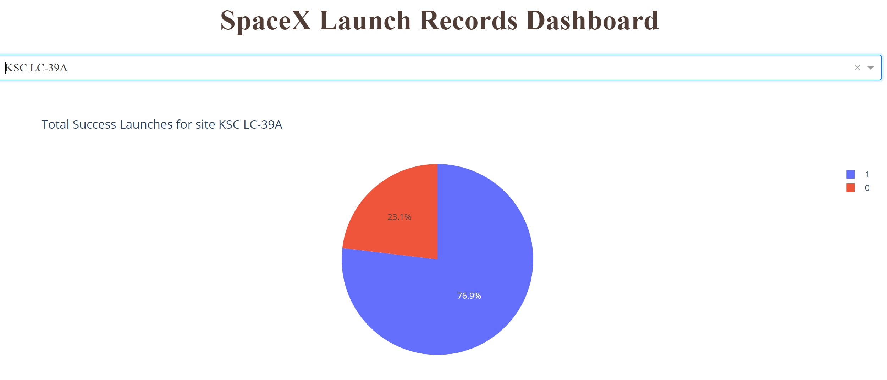
Piechart of Most Successful chaty
This piechart shows the most successful site, KSC LC-39A. It is broken down to show
that 76.9% of all flights were successful; whereas, a little over 20% were failures.

Slide 42
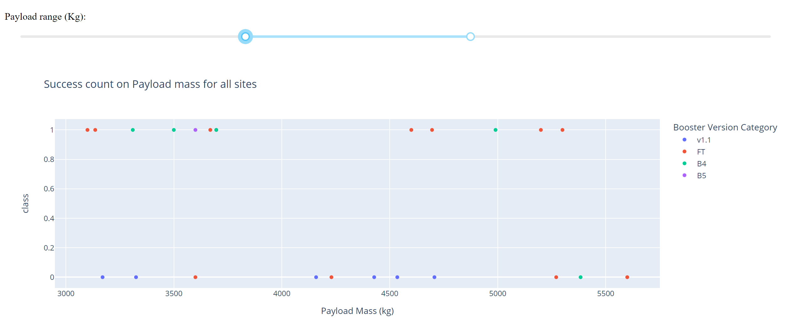
Payload vs. Launch Outcome Scatter Plot for All Sites
By changing the payload range slider to be between 3000 and 5500, you can see that the failure and success rate seemed to be about equal. This is divided by booster version for all sites.

Slide 43
Predictive Analysis
Section 6
(Classification)

Slide 44
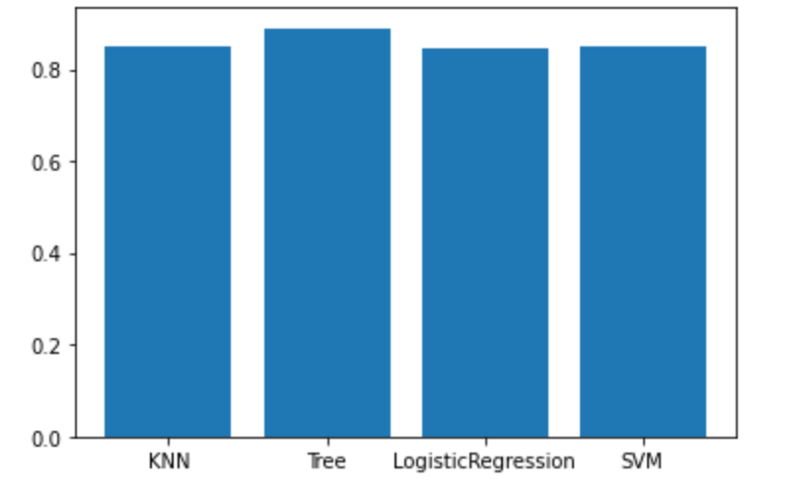
Classification Accuracy
The bar chart to the right shows the accuracy of each of the four models. All of them have a very high accuracy, but the Tree model has the highest accuracy.

Slide 45
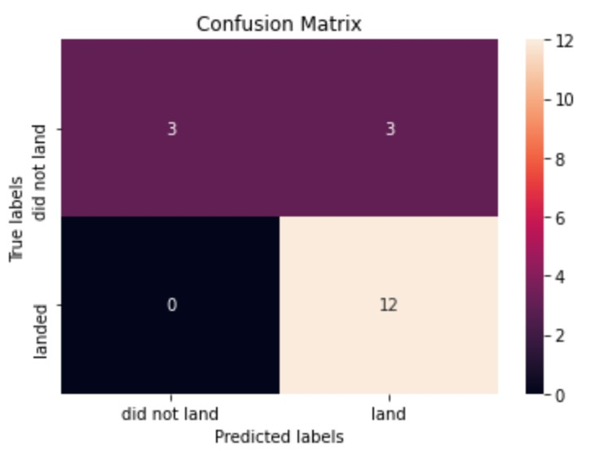
Confusion Matrix - Tree
This is the confusion matrix for the tree algorithm. It seems to predict if the flight landed well, but the confusion comes in when trying to predict when the flight did not land.

Slide 46
Conclusions
By visualizing the data, we were able to see that each year increases in successes. We also saw that payload mass was important when determining if it would fail
Using SQL allowed me to look through the data and understand what it was telling
me.
When creating a plotly dash, I found that the KSC LC-39A was the most successful
Using the folium map, I could better understand their locations and if that determined if they failed or not
Using the predictive analysis, I found that the best algorithm was the tree algorithm with an accuracy of 88.93%

Slide 47
Appendix
ALL code can be found in my github links throughout the presentation

Slide 48


